Slide 1
Significant figures
RULES TO MEMORIZE!

Slide 2
1.All measurements are inaccurate
2. Precision of measuring device
3. Human error
4. Faulty technique

Slide 3
Measurements need to convey precision
Must include degree of uncertainty
Sig Figs tell us

Slide 4
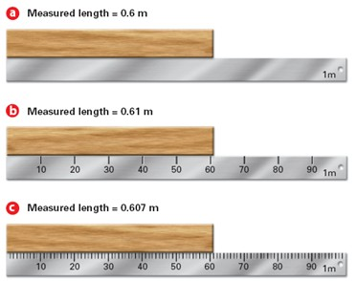
Significant figures

Slide 5
Significant figures in a measurement include
Rule 1
All of the digits that are known precisely plus one last digit that is estimated

Slide 6
Rule 2
Every non-zero digit is significant
Ex: 2.47 = 3 significant figures

Slide 7
Rule 3
Zeros between non- zeros are significant
ex. 24.0007 – 6 sig figs

Slide 8
Rule 4
Zeros in front of non-zeros are NOT SIGNIFICANT ex. 0.0099 – 2 sig figs

Slide 9
Rule 5
Zeros past a number to the right of a decimal are significant Ex. 43.00 – 4 sig figs

Slide 10
Rule 6
Zeros before understood decimals are NOT SIGNIFICANT ex. 100 – 1 sig fig

Slide 11
Rule 7
Zeros before indicated decimal are significant ex. 100. – 3 sig figs

Slide 12
Rule 8
Counts and exact quantities are infinitely significant ex. 12 eggs in a dozen 5280 ft in 1 mile

Slide 13
Rule 9
Adding and subtracting – retain as many places to the right of the decimal as the original number with the least decimal places.

Slide 14
Rule 10
If you multiply or divide two numbers, the answer is rounded off to the number of significant figures in the least precise term used in the calculation (i.e. the number with the fewest sig figs).

